Slide 1
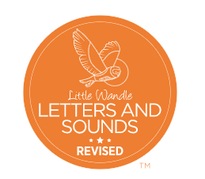
Monday
Autumn 1 - Week 4

Slide 2
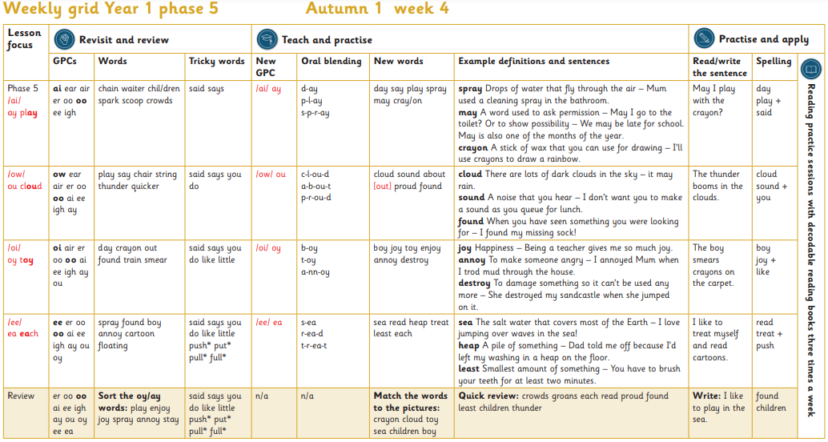

Slide 3

Lesson Focus
Monday
/oi/
oy toy

Slide 4
Revisit and review
GPCs
oi

Slide 5
Revisit and review
GPCs
air

Slide 6
Revisit and review
GPCs
er

Slide 7
Revisit and review
GPCs
oo

Slide 8
Revisit and review
GPCs
oo

Slide 9
Revisit and review
GPCs
ai

Slide 10
Revisit and review
GPCs
ee

Slide 11
Revisit and review
GPCs
igh

Slide 12
Revisit and review
GPCs
ay

Slide 13
Revisit and review
GPCs
ou

Slide 14



Slide 15
day
Revisit and Revise Word

Slide 16
crayon
Revisit and Revise Word

Slide 17
out
Revisit and Revise Word

Slide 18
found
Revisit and Revise Word

Slide 19
train
Revisit and Revise Word

Slide 20
smear
Revisit and Revise Word

Slide 22

Which part of the word tricky?

Slide 23
said
Revisit and Revise
Tricky Word

Slide 24
says
Revisit and Revise
Tricky Word

Slide 25
you
Revisit and Revise
Tricky Word

Slide 26
do
Revisit and Revise
Tricky Word

Slide 27
like
Revisit and Revise
Tricky Word

Slide 28
little
Revisit and Revise
Tricky Word

Slide 30
New GPC
/oi/
oy

Slide 31
b oy
Oral blending

Slide 32
t oy
Oral blending

Slide 33

a nn oy
Oral blending

Slide 34


b oy
New Word

Slide 35
j oy
New Word

Slide 36
t oy
New Word

Slide 37
e n j oy
New Word

Slide 38
a nn oy
New Word

Slide 39
d e s t r oy
New Word

Slide 41
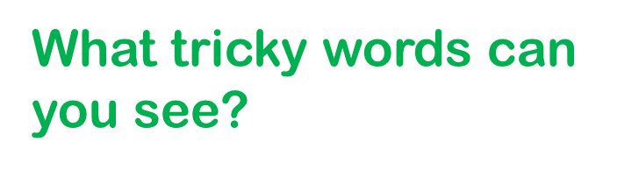

The boy smears crayons on the carpet.
Read the sentence
What punctuation can you see?

Slide 42
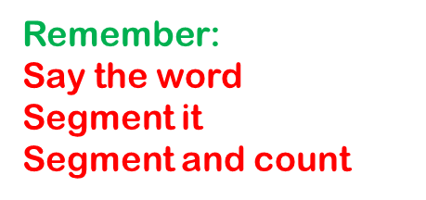
boy joy like
Spelling

Slide 43
Tuesday
Autumn 1 - Week 4

Slide 45
Revisit and review
GPCs
ee

Slide 46
Revisit and review
GPCs
er

Slide 47
Revisit and review
GPCs
oo

Slide 48
Revisit and review
GPCs
oo

Slide 49
Revisit and review
GPCs
ai

Slide 50
Revisit and review
GPCs
ee

Slide 51
Revisit and review
GPCs
igh

Slide 52
Revisit and review
GPCs
ay

Slide 53
Revisit and review
GPCs
ou

Slide 54
Revisit and review
GPCs
oy

Slide 56
spray
Revisit and Revise Word

Slide 57
found
Revisit and Revise Word

Slide 58
boy
Revisit and Revise Tricky Word

Slide 59
annoy
Revisit and Revise Word

Slide 60
cartoon
Revisit and Revise Word

Slide 61
floating
Revisit and Revise Word

Slide 63
Which part of the word tricky?

Slide 64
said
Revisit and Revise
Tricky Word

Slide 65
says
Revisit and Revise
Tricky Word

Slide 66
you
Revisit and Revise
Tricky Word

Slide 67
do
Revisit and Revise
Tricky Word

Slide 68
like
Revisit and Revise
Tricky Word

Slide 69
little
Revisit and Revise
Tricky Word

Slide 70
push
Revisit and Revise
Tricky Word

Slide 71
put
Revisit and Revise
Tricky Word

Slide 72
pull
Revisit and Revise
Tricky Word

Slide 73
full
Revisit and Revise
Tricky Word

Slide 75
New GPC
/ee/
ea

Slide 76
s ea
Oral blending

Slide 77

r ea d
Oral blending

Slide 78
t r ea t
Oral blending

Slide 79
s ea
New Word

Slide 80
s ea
New Word

Slide 81
r ea d
New Word

Slide 82
h ea p
New Word

Slide 83
t r ea t
New Word

Slide 84
l ea s t
New Word

Slide 85
ea ch
New Word

Slide 87
I like to treat myself and read cartoons.
Read the sentence
What punctuation can you see?

Slide 88

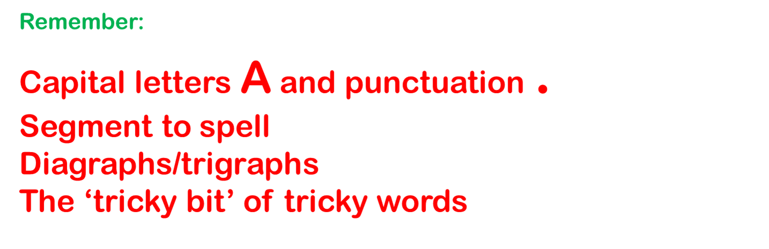
Write the sentence

Slide 89
read treat push
Spelling

Slide 90
Wednesday
Autumn 2 - Week 1

Slide 91
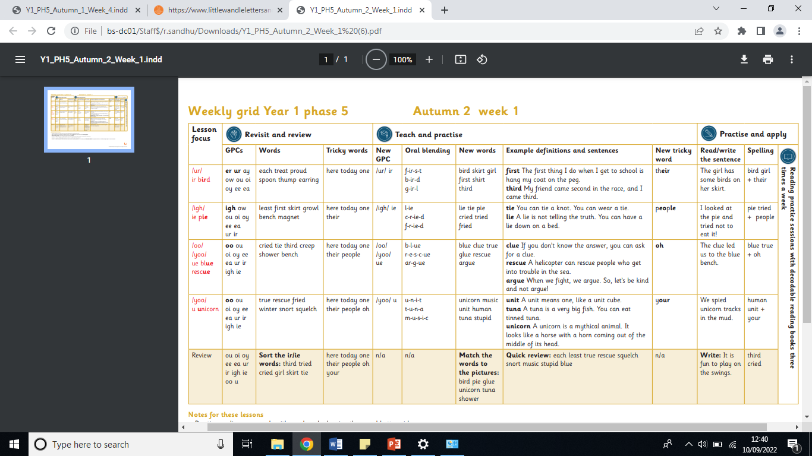

Slide 92
Lesson Focus
Wednesday
/ ur /
ir bird

Slide 93
Revisit and review
GPCs
er

Slide 94
Revisit and review
GPCs
ur

Slide 95
Revisit and review
GPCs
ay

Slide 96
Revisit and review
GPCs
ow

Slide 97
Revisit and review
GPCs
ou

Slide 98
Revisit and review
GPCs
oi

Slide 99
Revisit and review
GPCs
oy

Slide 100
Revisit and review
GPCs
ee

Slide 101
Revisit and review
GPCs
ea

Slide 103
each
Revisit and Revise Word

Slide 104
treat
Revisit and Revise Word

Slide 105
proud
Revisit and Revise Word

Slide 106
spoon
Revisit and Revise Word

Slide 107
thump
Revisit and Revise Word

Slide 108
earring
Revisit and Revise Word

Slide 109
here
Revisit and Revise Tricky Word

Slide 110
today
Revisit and Revise Tricky Word

Slide 111
one
Revisit and Revise Tricky Word

Slide 112
New GPC
/ur/
ir

Slide 113

f ir s t
Oral blending

Slide 114
b ir d
Oral blending

Slide 115

g ir l
Oral blending

Slide 116
b ir d
New Word

Slide 117

s k ir t
New Word

Slide 118
g ir l
New Word

Slide 119
f ir s t
New Word

Slide 120
sh ir t
New Word

Slide 121
th ir d
New Word

Slide 122
their
New
Tricky Word

Slide 123
The girl has some birds on her skirt.
Read the sentence
What punctuation can you see?

Slide 124
Write the sentence

Slide 125
bird girl their
Spelling

Slide 126
Thursday
Autumn 2 - Week 1

Slide 128
Lesson Focus
Thursday
/ igh/
ie pie

Slide 129
Revisit and review
GPCs
igh

Slide 130
Revisit and review
GPCs
ow

Slide 131
Revisit and review
GPCs
ou

Slide 132
Revisit and review
GPCs
oi

Slide 133
Revisit and review
GPCs
oy

Slide 134
Revisit and review
GPCs
ee

Slide 135
Revisit and review
GPCs
ea

Slide 136
Revisit and review
GPCs
ur

Slide 137
Revisit and review
GPCs
ir

Slide 139
least
Revisit and Revise Word

Slide 140
first
Revisit and Revise Word

Slide 141
skirt
Revisit and Revise Word

Slide 142
growl
Revisit and Revise Word

Slide 143
bench
Revisit and Revise Word

Slide 144
magnet
Revisit and Revise Word

Slide 145
here
Revisit and Revise Tricky Word

Slide 146
today
Revisit and Revise Tricky Word

Slide 147
one
Revisit and Revise Tricky Word

Slide 148
their
Revisit and Revise Tricky Word

Slide 149
New GPC
/igh/
ie

Slide 150
l ie
Oral blending

Slide 151
c r ie d
Oral blending

Slide 152
f r ie d
Oral blending

Slide 153
l ie
New Word

Slide 154
t ie
New Word

Slide 155
p ie
New Word

Slide 156
c r ie d
New Word

Slide 157
t r ie d
New Word

Slide 158
f r ie d
New Word

Slide 159
people
New
Tricky Word

Slide 160
I looked at the pie and tried not to eat it!
Read the sentence
What punctuation can you see?

Slide 161
Write the sentence

Slide 162
pie tried people
Spelling

Slide 163
Friday
Autumn 2 - Week 1

Slide 165
Lesson Focus
Friday
/ oo /
ue blue

Slide 166
Revisit and review
GPCs
oo

Slide 167
Revisit and review
GPCs
ou

Slide 168
Revisit and review
GPCs
oi

Slide 169
Revisit and review
GPCs
oy

Slide 170
Revisit and review
GPCs
ee

Slide 171
Revisit and review
GPCs
ea

Slide 172
Revisit and review
GPCs
ur

Slide 173
Revisit and review
GPCs
ir

Slide 174
Revisit and review
GPCs
igh

Slide 175
Revisit and review
GPCs
ie

Slide 177
cried
Revisit and Revise Word

Slide 178
tie
Revisit and Revise Word

Slide 179
third
Revisit and Revise Word

Slide 180
creep
Revisit and Revise Word

Slide 181
shower
Revisit and Revise Word

Slide 182
bench
Revisit and Revise Word

Slide 183
here
Revisit and Revise Tricky Word

Slide 184
today
Revisit and Revise Tricky Word

Slide 185
one
Revisit and Revise Tricky Word

Slide 186
their
Revisit and Revise Tricky Word

Slide 187
people
Revisit and Revise Tricky Word

Slide 188
New GPC
/oo/
ue

Slide 189
b l ue
Oral blending

Slide 190
r e s c ue
Oral blending

Slide 191
ar g ue
Oral blending

Slide 192
b l ue
New Word

Slide 193
c l ue
New Word

Slide 194
t r ue
New Word

Slide 195
g l ue
New Word

Slide 196
r e s c ue
New Word

Slide 197
ar g ue
New Word

Slide 198
oh
New
Tricky Word

Slide 199
The clue led us to the blue bench.
Read the sentence
What punctuation can you see?

Slide 200
Write the sentence

Slide 201
blue true oh
Spelling

